Slide 1
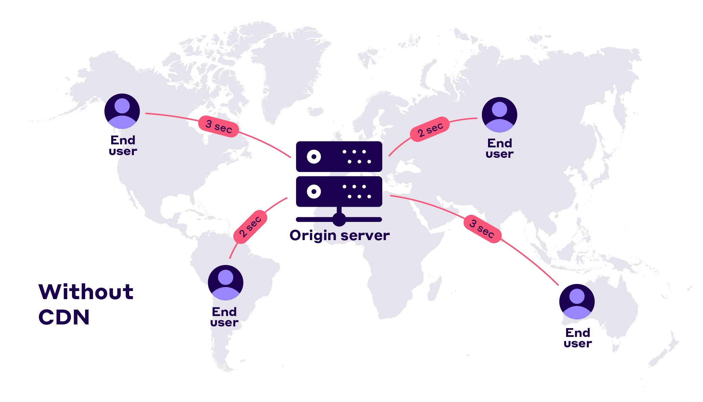
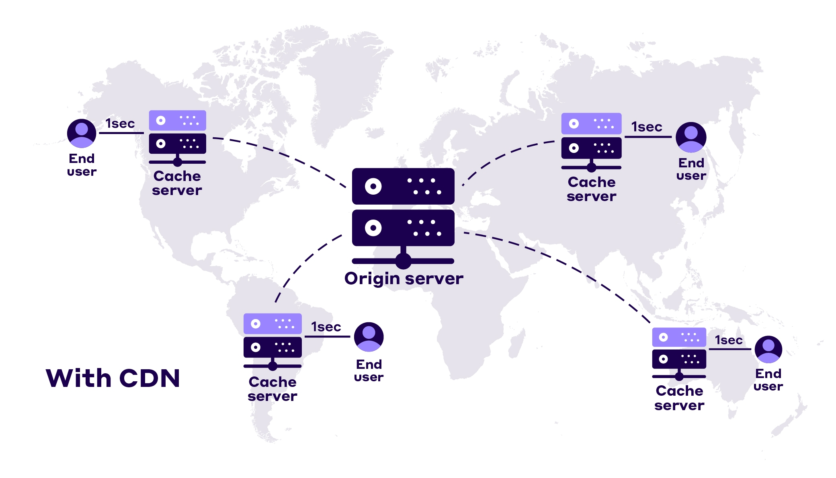
What is a CDN ?
A CDN is a geographically distributed network of servers that work together to deliver web content (like HTML pages, JavaScript files, stylesheets, images, and videos) to users based on their geographic location.
The primary purpose of a CDN is to deliver content to end-users with high availability and performance by reducing the physical distance between the server and the user.
When a user requests content from a website, the CDN redirects the request to the nearest server in its network, reducing latency and improving load times.

Slide 2
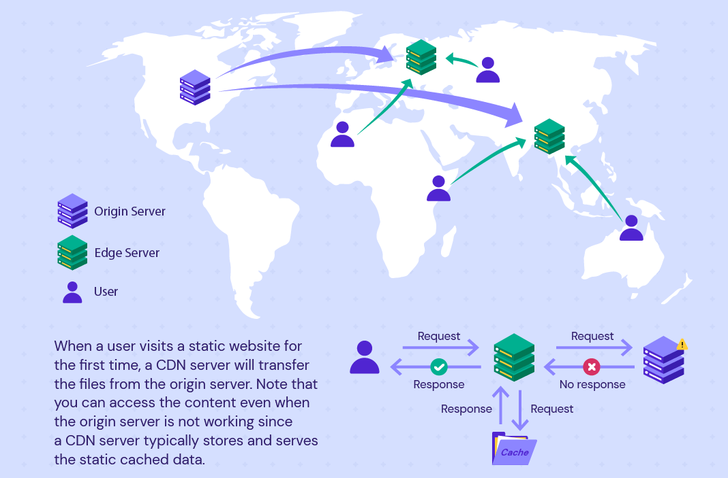
How Does a CDN Work?
A CDN operates using three key components:
Edge Servers – Located at Points of Presence (PoP) locations, these servers cache and deliver content closer to users.
Origin Servers – The primary servers where the original content is stored.
DNS (Domain Name System) – Directs user requests to the nearest edge server instead of the origin server.
By leveraging edge servers distributed across multiple geographical regions, CDNs minimize latency and accelerate content delivery

Slide 3
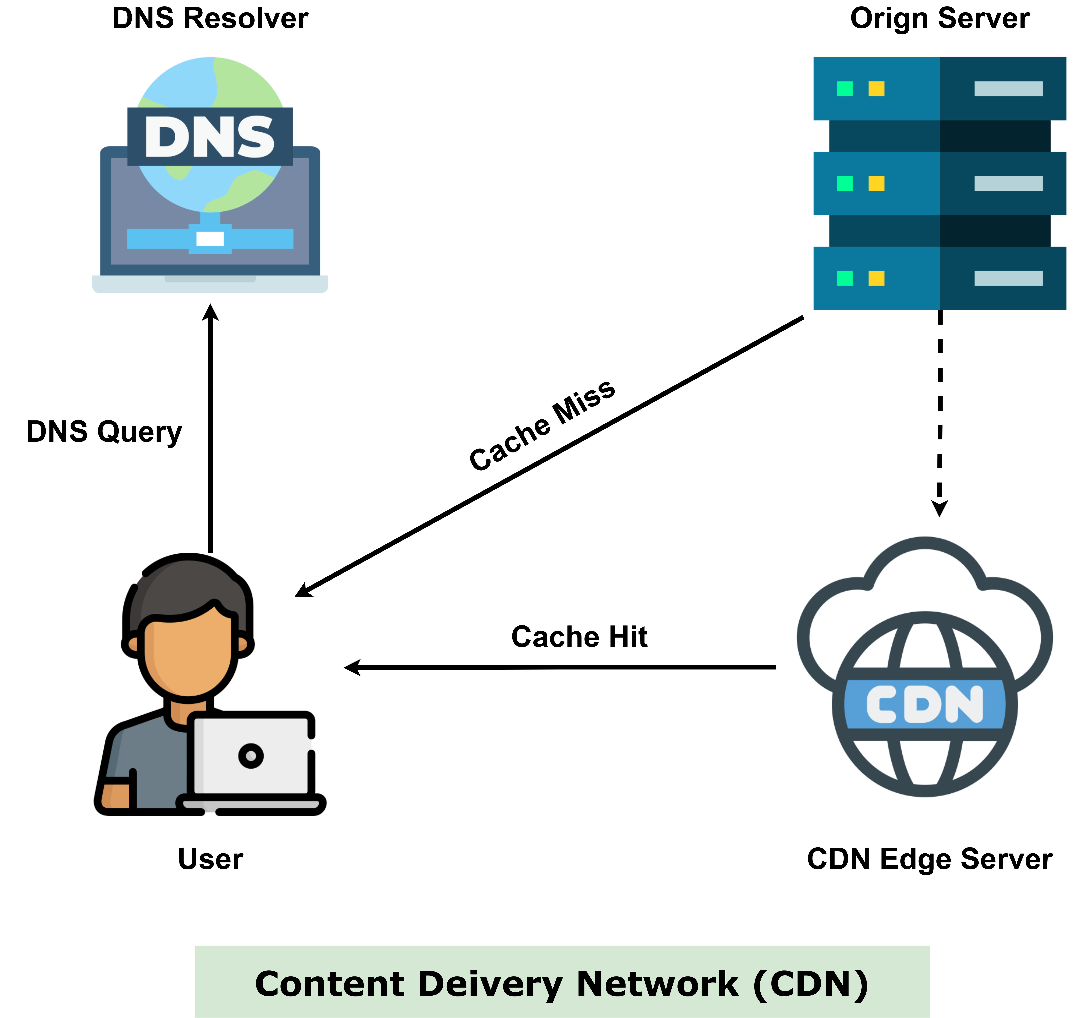
How Does a CDN Work?
Here’s a step-by-step breakdown of how a CDN works:
User Request – A user visits a website and requests content, such as an image, a webpage, or a video. This request must be resolved to a server that can serve the content.
DNS Resolution – The browser sends a DNS query to resolve the web content address (e.g., https://cdn.example.com/images/logo.png) into an IP address. The DNS return the nearest CDN edge server’s IP address rather than the origin server.
Cache Check
If the content is already cached at the edge server, it is served immediately to the user.
If not, the edge server forwards the request to the origin server. The origin server processes the request and sends the content back to the edge server. The edge server caches the content it retrieved from the origin server.
Subsequent Requests – Once cached, future requests for the same content are served directly from the edge server, reducing load on the origin and improving speed.
CDNs use a Time-to-Live (TTL) mechanism to determine how long content remains cached before expiring. To ensure users always receive the latest version, CDNs periodically refresh and update cached content from the origin server.

Slide 4
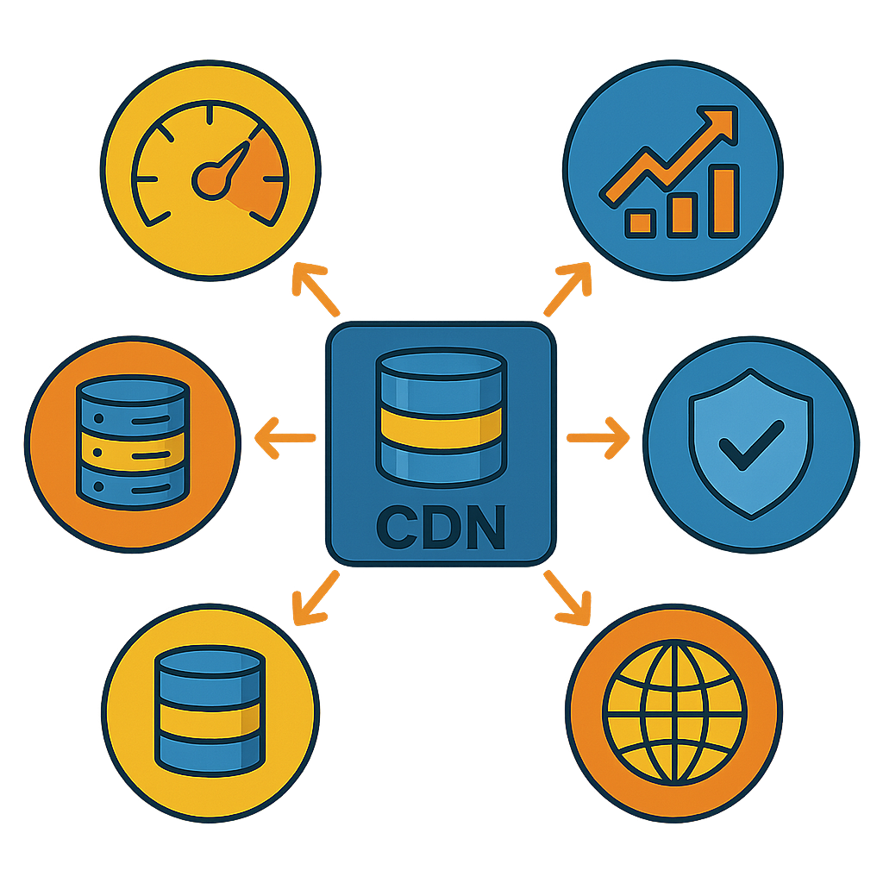
Benefits of Using a CDN
Faster Load Times – By serving content from the nearest edge server, CDNs reduce latency and improve page load speed.
Reduced Server Load – CDNs offload traffic from the origin server by caching static assets, reducing resource consumption.
Improved Availability and Reliability – With multiple servers in different locations, CDNs prevent single points of failure.
Scalability: CDNs can handle traffic spikes more efficiently than traditional hosting, making them ideal for websites with fluctuating traffic patterns.
Global Reach: CDNs make it easier to deliver content to users worldwide, regardless of their location.
Enhanced Security – Many CDNs offer DDoS protection, Web Application Firewalls (WAFs), and bot mitigation to secure applications.
While CDNs offer many benefits, it’s important to note that they also introduce some challenges like:
Increased Complexity: Integrating a CDN requires proper DNS configuration, cache rules, and content invalidation policies.
Increased Cost: Many CDN providers charge based on bandwidth usage and request volume. For high-traffic websites, CDN costs can be substantial, especially for video streaming, gaming, and software distribution.

Slide 5
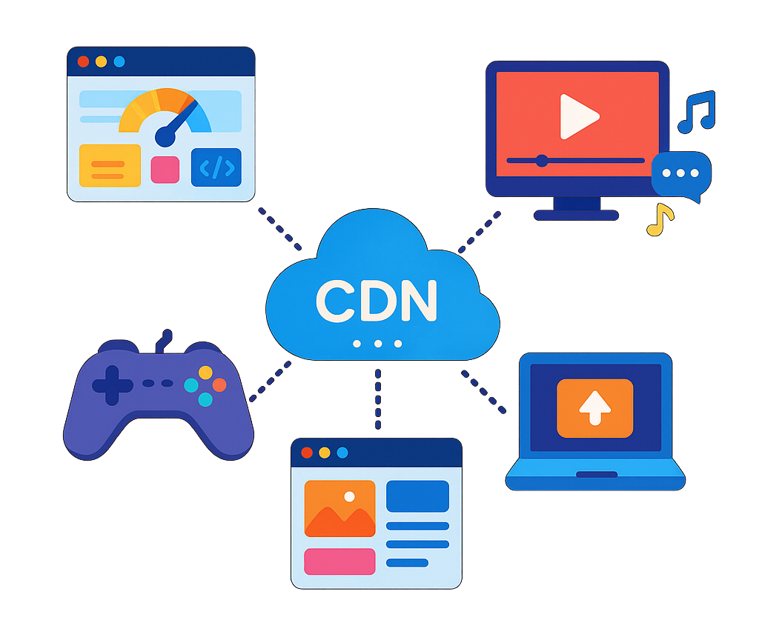
Use Cases of CDNs
Accelerating Website Performance
Websites with global traffic use CDNs to ensure fast page loads for users regardless of location.
CDNs cache static assets (images, CSS, JavaScript) at edge servers, reducing the time required to fetch them from the origin.
Video Streaming & OTT Platforms
CDNs optimize video content delivery by caching video files closer to users, minimizing buffering and latency.
Supports adaptive bitrate streaming (ABR) to serve video based on the user’s internet speed.
Example: Netflix, YouTube, and Spotify use CDNs to serve videos and music in real-time to user.
Online Gaming
Multiplayer online games require low-latency content delivery to ensure a smooth gaming experience.
CDNs help distribute game updates, patches, and downloadable content (DLCs) faster.
Content & Media Distribution
News websites and content platforms deliver images, articles, and videos through a CDN to handle large traffic spikes.
Software Distribution & Updates
Operating system and software vendors use CDNs to distribute large files, updates, and patches quickly.
Accelerates the distribution of software updates and applications to users worldwide.
Example: Microsoft, Apple, and Google use CDNs for distributing Windows updates, macOS updates, and Android app downloads.

Slide 6
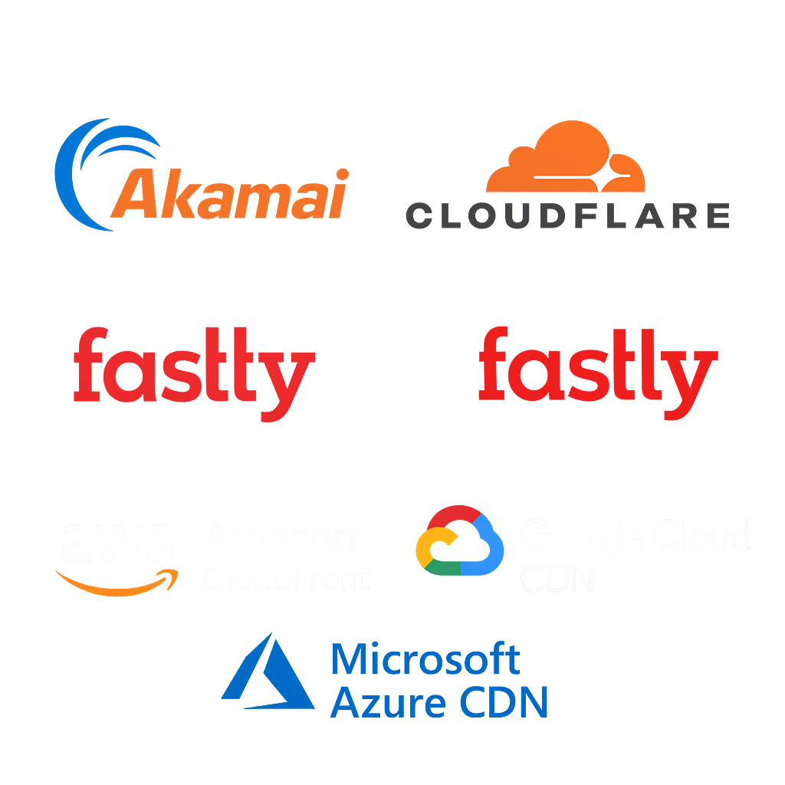

Popular CDN Providers
Here are some of the most widely used CDN providers:
Akamai: One of the oldest and largest CDN providers, known for its extensive global network and robust security features.
Cloudflare: Offers a comprehensive suite of performance and security services, including a free tier for smaller websites.
Fastly: Known for its real-time content delivery and edge computing capabilities.
Amazon CloudFront: Integrated with AWS, provides seamless scalability and extensive integration with other AWS services.
Google Cloud CDN: Leverages Google’s global network infrastructure to ensure high performance and low-latency content delivery.
Microsoft Azure CDN – Designed for applications hosted on Microsoft Azure, providing seamless integration with other Azure services.
Selecting the best CDN depends on your use case, budget, and platform integration requirements.

